Slide 1
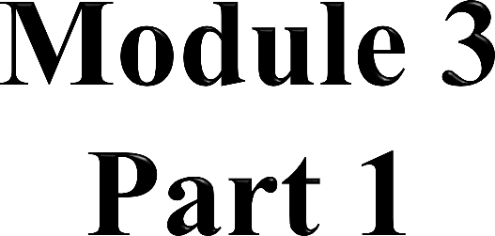

Stream Processing in IoT

Slide 2

Introduction
Stream
Stream Processing
Data Stream Management System (DSMS)
Complex Event Processing (CEP)
Differences between DSMS and CEP
The characteristics of stream data in IoT
General architecture of a stream-processing system in IoT
Continuous logic processing system
Challenges in stream-processing systems

Slide 3

 Nowadays, building a modern information-technology system demands
the ability of
Processing an unprecedented volume of data using possibly distributed resource
Exploring the concealed value of data within a tight time- constraint

Slide 4
Batch-processing model derives a series of techniques to accomplish
to accomplish the first goal
MapReduce, for example, is a highly scalable and widely adopted programing model that is specialized in processing parallelization
Various NoSQL databases are developed alongside traditional relational databases, which allows for an extent of flexibility in data representation to handle the increasing variety of data formats and to obtain finer control over scalability and availability

Slide 5
These batch-based techniques are relatively competent in terms of handling the ever-growing data volume and increasingly complex data format
However, they are all struggling to meet the second goal
In this context, stream processing is proposed to processing continuous data-volume in real-time
Both data aggregation and analysis in the streaming model normally have a strict deadline specified
Which means completing the job beyond the deadline is not only considered as degradation of performance, but as a failure to deliver the immediate insights

Slide 6
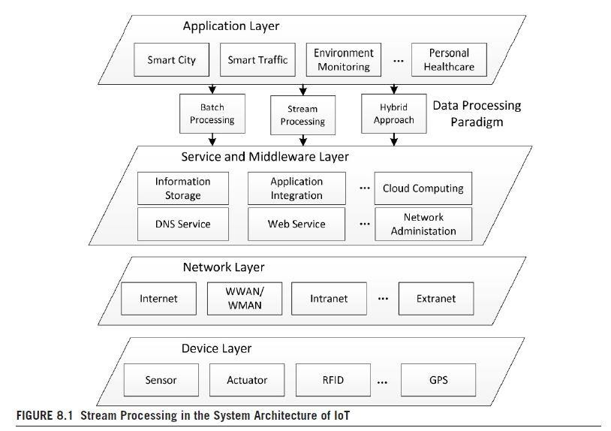

Slide 7
Stream processing has always been an integral part of Internet of
Things (IoT) applications, as it offers a scalable, highly available, and fault-tolerant solution to handle a high volume of data in motion
As shown in Fig. 8.1, the architecture of IoT outlines the importance of stream processing and how it is connected with the rest of the system
From the perspective of an application developer, stream processing mainly works as a connecting bridge between the application layer and
the service and middleware layer, which allows the upper logic to make appropriate use of the underlying general purpose services and infrastructures

Slide 8

A stream is a sequence of data elements ordered by time
The structure of a stream could consist of discrete signals, event logs, or any combination of time-series data
In terms of representation, a data stream has an explicit timestamp associated with each element, which serves as a measurement of data order
Based on this, we formally define the denotation of stream in the context of IoT, as a Data Element–Time pair (s, Δ)

Slide 9
s is a sequence of data elements that are made available to the processing system over time
A data element may consist of several attributes, but it is normally atomic
Typical element types include immutable data tuples of the same or similar category, as well as heterogeneous events that come from a variety of sources
Depending on the specific application scenario, data elements can be either regularly generated by sensor networks or randomly produced by real-world events such as updates to a particular database table, and system logs produced by Internet services

Slide 10
Δ is a sequence of a timestamp that denotes the sequence of data elements
The use of a timestamp is necessary to reconstruct the logic sequence for the analytics
In addition, timestamps can be also used to evaluate the real-time property of a stream-processing system, by checking on whether the results have been presented on time
Normally, timestamps can be implemented in two forms
as a string of absolute timevalues
as a sequence of positive real-time intervals

Slide 11

Stream processing is a one-pass data-processing paradigm that always keeps the data in motion to achieve low processing-latency
Stream processing supports not only the message aggregation and delivery, but also is capable of performing real-time asynchronous computation
The most important feature of the streaming paradigm is that it does not have access to all data
By contrast, it normally adopts the one-at-a-time processing model, which applies standing queries or established rules to data streams in order to get immediate results upon their arrival

Slide 12
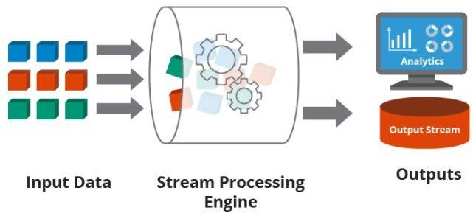

Slide 13
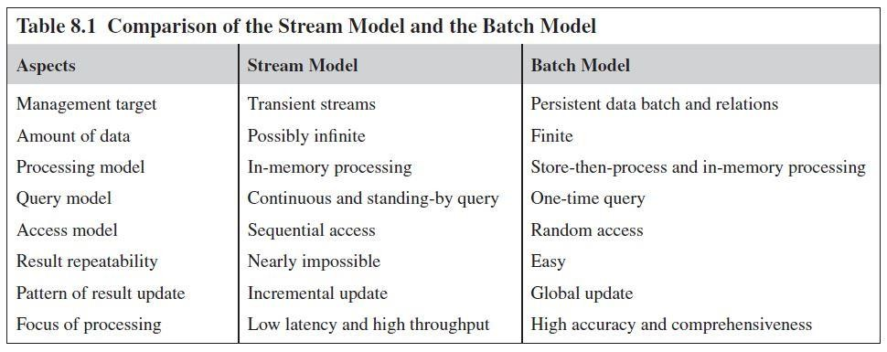
All of the computation in this paradigm is handled by the continuously dedicated logic-processing system, which is a scalable, highly available, and fault-tolerant
As a consequence of the timeliness requirement, computations for analytics and pattern recognition should be relatively simple and generally independent

Slide 14
DSMS and CEP
When it comes to the application of stream processing, we have identified two different types of use cases
  Data Stream Management System (DSMS)
  Complex Event Processing (CEP)

Slide 15
Analogous to the traditional DBMS
Goal is to manipulate a huge amount of available data to constitute data synopsis, schema, or some other mathematical or statistical model that is easy to understand and interpret
Specifically, data streams within the DSMS are joined, filtered, and transformed with the use of continuous and long-standing queries
However, since the throughput requirement of stream processing has increased during the recent decade and the corresponding DSMS has become increasingly distributed

Slide 16
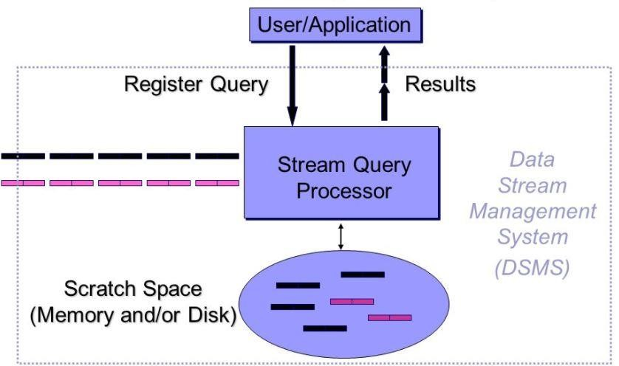

Slide 17
Sticking to such a declarative model makes it painful to horizontally scale, and even harder to maintain the required availability and fault- tolerance ability
Therefore, adopts a better way to implement long-time queries, by using the provided programming API
A typical use-case of DSMS includes face recognition from a continuous video stream, and the calculation of user preference according to his or her click history

Slide 18
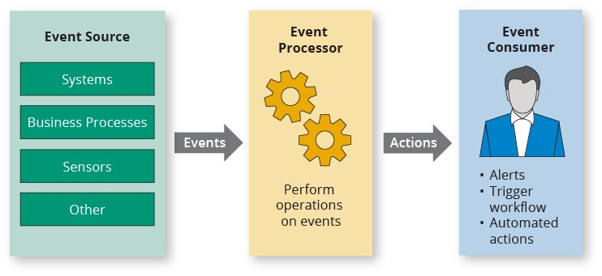
 Which is essentially tracking and processing streams of raw events in order to derive significant events and identify meaningful insights from them

Slide 19
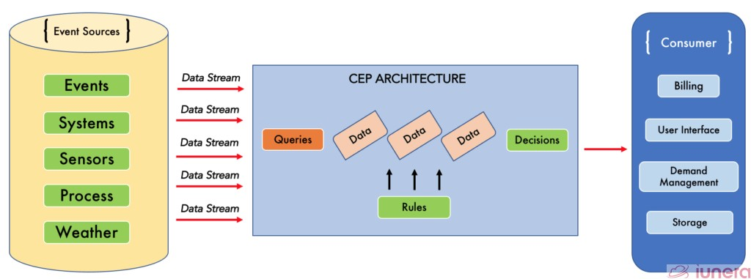
There are several techniques being used to achieve that goal
The most notable one is to implement and configure the processing logic as a set of inferring rules in the knowledgebase so that they could be used in the decision-making process of identifying complex patterns

Slide 20
To define and preserve the mutual relationship of events, various types of event-processing languages have been proposed
Besides, CEP systems normally require that the maintenance of state and the preservation of event relationship, which makes the microbatch model a preferable option compared to the one-at-a-time model.
The primary goal of DSMS is – it performs stream analytics at a geographically concentrated place
The primary goal CEP is - to infer the needed insight from the vast volume of raw events to stream as fast as possible

Slide 21
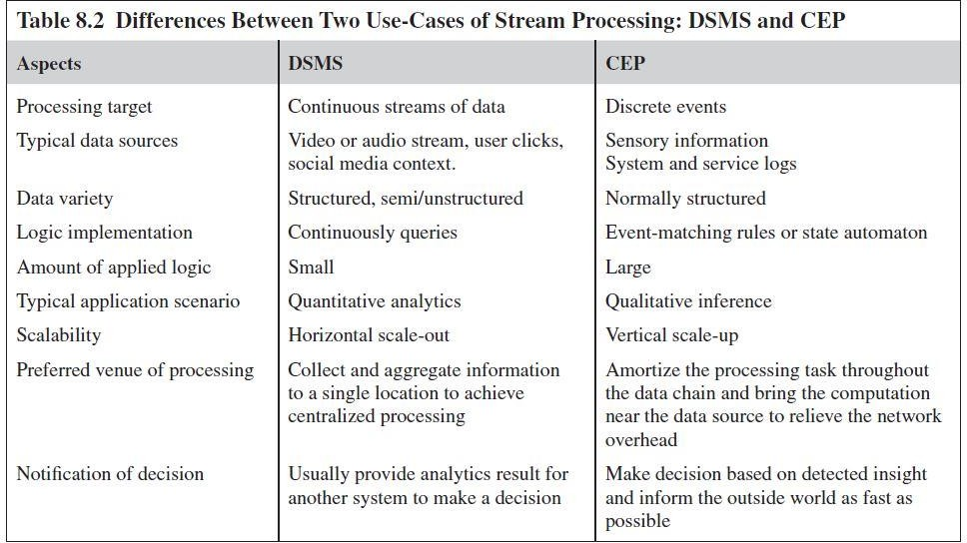
Apache Storm can easily fulfill the requirement of CEP paradigm to become a typical event-processing platform that is capable of identifying meaningful patterns from incoming raw events

Slide 22
To guarantee timely processing, it's essential to collect, transmit, process, and present streaming data in real-time.
Timeliness can be measured in terms of latency, which is the time it takes for data to travel from the source to the destination, be processed, and produce a response. Ensuring timely data handling is crucial in some applications.
Therefore, it is necessary to build an adaptive platform that can elastically scale with respect to fluctuating processing demands. It should still remain portable and configurable in response to the continuously shifting processing needs.

Slide 23
Randomness and data imperfection are two direct consequences of the dynamic nature of stream data
The data generation process may induce randomness because the data sources are normally independently installed in different environments, which makes it nearly impossible to guarantee the sequence of data arrival across different streams
The data transmission process can also result in disorder and other defections, as some tuples may be lost, damaged, or delayed due to the constantly changing network conditions

Slide 24
 As long as the data sources are alive and the stream-processing system is properly functioning, newly generated data will be continuously appended to the data channel until the whole application is explicitly turned off
Most of the stream data will be discarded once they have finished traversing through the streamprocessing system, which makes the existence of data quite volatile
Even if the data sources are able to replay the data stream upon the retransmit request, the new stream is unlikely to be exactly the same as the previous one

Slide 25
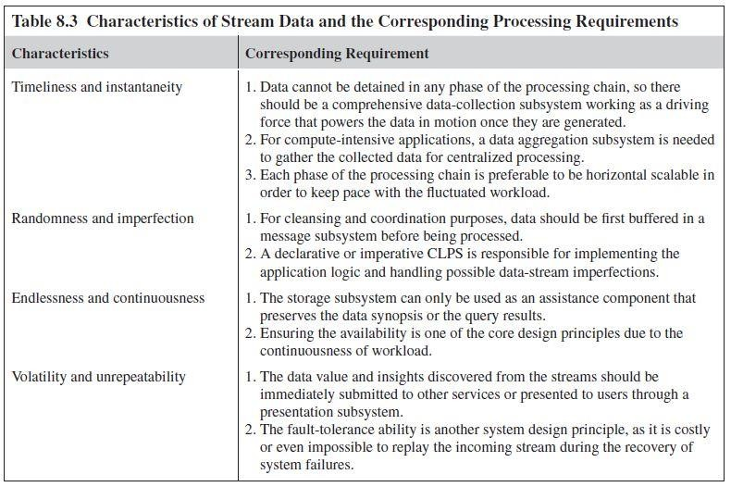

Slide 26
A stream-processing architecture should include an integral data- processing chain that covers the whole lifespan of data (from its generation up to its consumption)
Fig. 8.2 presents a general architecture of a stream-processing system
This architecture breaks down the whole data-processing chain into several stages according to the functionality and target
Identified six separate streaming components which are responsible for data generation, collection, buffering, logic processing, storage, and presentation, respectively

Slide 27
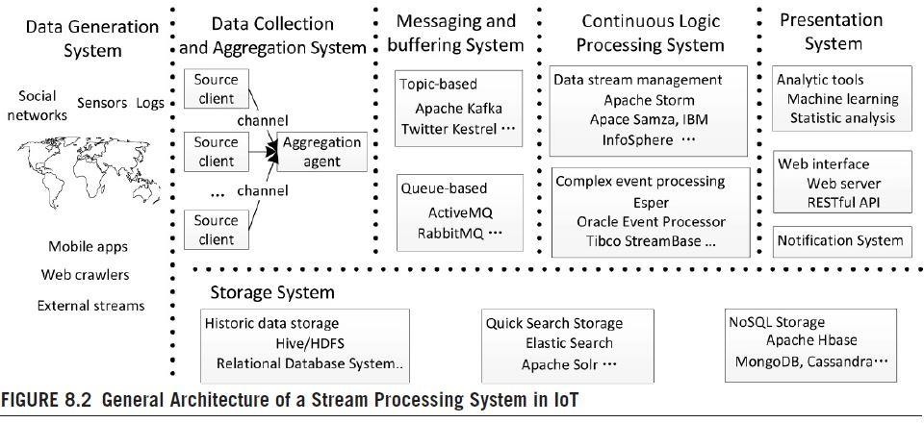

Slide 28
The data-generation system denotes the spectrum of data sources that continuously produce raw information for the data-processing chain.
We can still categorize the generated data into three types
Static data, refers to the long-term information that has already been stored in remote locations
Centralized stream data, is a special type of stream that only comes from a single centralized data source
Distributed stream data is the most common data type used in IoT applications, where data of this type dynamically come from various distributed places in heterogeneous formats, such as sensory information from sensor networks

Slide 29
 To collect and aggregate different types of data, various forms of source clients are independently installed, while several aggregation channels are provided to gather these stream data into a centralized buffer, using hierarchical aggregation agents
Plays the role of a message broker in the whole data-processing chain
There are two types of message buffers; some are topic-based, which support a higher-level programmability, whereas the others are queue- based, and thus mainly optimized for performance concerns

Slide 30

Supportive components for a stream-processing architecture
Keeping all the data, that need to be stored are either established knowledge, which can guide the future processing, or meaningful data synopsis, which might arouse the future interest of users
It is responsible for processing aggregated data according to the designated continuous logic
Which could either come from the Data Stream Management or Complex Event Processing background

Slide 31
Supportive components for a stream-processing architecture
Serves as an interface for immediately hands over the data value to the higher level analytic tools, or directly delivers the results or notifications to the end users
It is also responsible for receiving search-command or query updates from the external environment so that it can make the stream- processing system more adaptive and responsive

Slide 32
The origin of the CLPS dates back to the beginning of this century
The first generation of CLPS, pioneered by NiagaraCQ and STREAM is only suited for certain processing scenarios in which only a small amount of data are generated
In addition to that, the types of operations supported by these prototypes are also limited
They are usually used as functional extensions of the existing Data Base Management Systems (DBMS)
NiagaraCQ defines a simple command-language to create and drop continuous queries over XML files
STREAM directly supports SQL-like query language

Slide 33
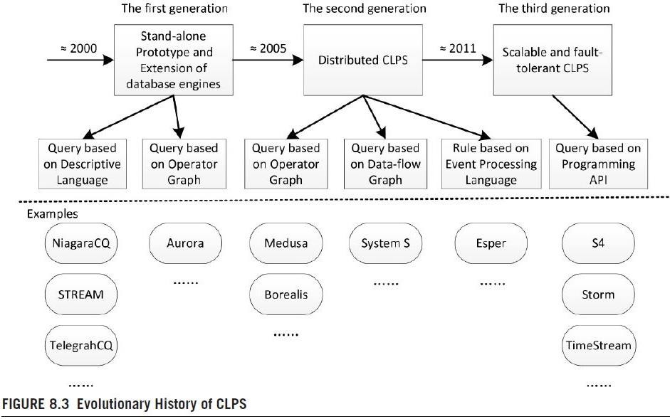

Slide 34
TelegraphCQ is developed on PostgreSQL to cope with the high value and diverse data streams, and enables the possibility of adaptive querying
Aurora is the last breakthrough founded in the first generation of CLPS, here the continuous queries are implemented by explicit operator graphs rather than declarative query languages such as SQL
The project Medusa is an extension to Aurora, which leads to a scalable and QoS-oriented architecture
Borealis engine was developed on top of Medusa in order to integrate some advanced capabilities, including dynamic query modification, result revision, and flexible monitoring

Slide 35
System S developed by IBM, proposed a query model based on data- flow graph to hide the implementation details as much as possible
The core objective is to achieve highly scalable, resource-efficient processing with a balanced resource-allocation mechanism
Esper is suitable for distributed event processing that has different types of events defined
S4 developed by Yahoo! is generally perceived as the first CLPS that meets the criteria of fully scalable and fault-tolerant
Storm supports almost arbitrary programming languages such as Clojure, Java, Ruby, and Python to implement the spouts and bolts, which are the logical operations in Storm
TimeStream written in C# by Microsoft, it is able to handle an aggregation data-source with a data generation speed of 700,000 URLs per s

Slide 36
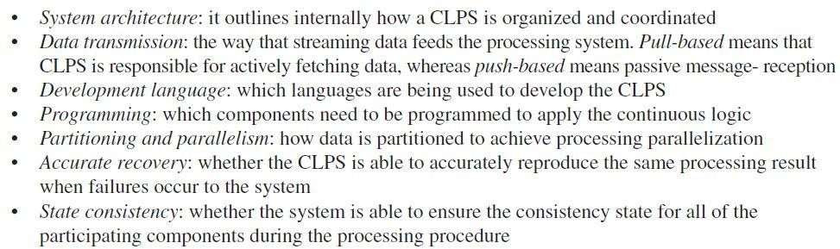
 As shown in Table 8.4, we compare these alternatives in terms of,

Slide 37
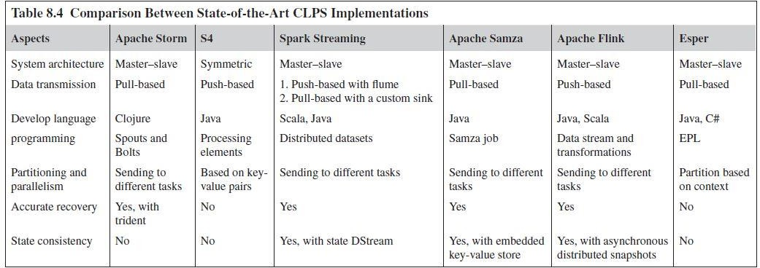

Slide 38
 The current stream-processing systems have been greatly improved to cater to the emerging needs of IoT applications
A stream-processing system now should satisfy the following criteria:
  Horizontal scalability to accommodate different sizes of processing needs
  Easy to program and manage
  Capable of dealing with possible hardware faults
The following aspects summarize the challenges that still need to be further addressed
Scalability
Robustness
SLA-Compliance
Load Balancing

Slide 39

Scalability does not just refer to the ability to expand the system to catch up to the ever-increasing data streams, so that the promise of the Quality of Service (QoS) or Service Level Agreement (SLA) could be honored
Elasticity, the ability to dynamically scale to the right size on demand, is the future and advanced form of scalability
The user requirement may change over time, the system should dynamically provision new resources by taking into account the characteristics of the available hardware infrastructure, and free up some of them when they are no longer needed

Slide 40

Fault-tolerance is a common place topic when it comes to the design and implantation of stream processing systems
Its availability is one of the most crucial prerequisites to guarantee the correctness and significance of real-time processing
Designing a hybrid and configurable fault-tolerance mechanism that is capable of recovering the system from unforeseeable failures is an open research-question left to be answered

Slide 41


It depends on which platform the system is running on, and how stakeholders are involved
But an inherent requirement is to achieve cost-efficiency, which minimizing the monetary cost for the users, as well as reducing the operational cost for the provider (possibly data centers)
The major target of which is to normally improve the performance of the system, especially by maximizing the throughput
A wrong balancing decision may lead to unnecessary load-shedding, dropping arrived messages when the system is deemed to be overloaded, which impairs the veracity of the processing result

